Slide 1
Global Industry Performance Review 2021
A must have for global exhibition executives and stakeholders
Outline of the report
Published by:
In partnership with:

Slide 2
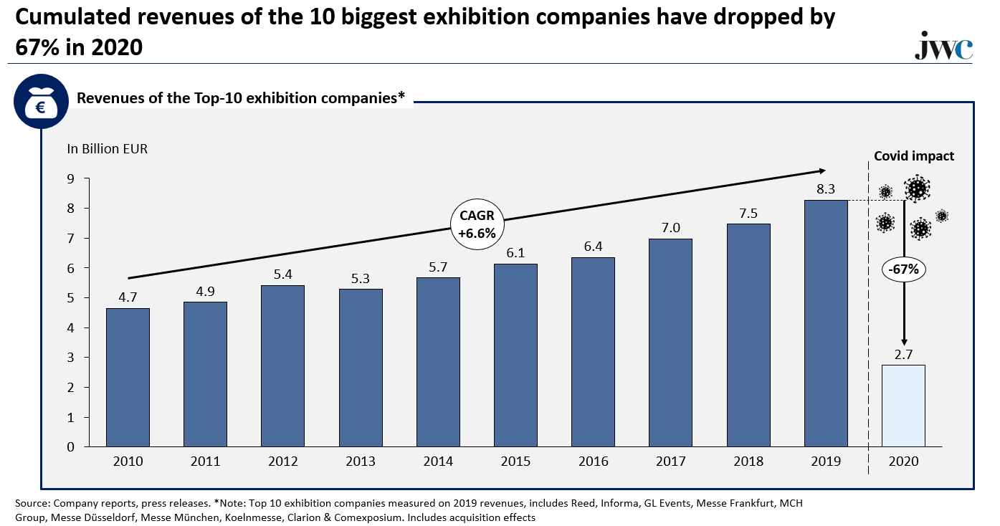
1
Introduction
Economy & exhibition industry
2
The Global Industry Performance Review 2021 (GIPR) is a comprehensive 200-page annual report of the global exhibition industry. Published by the globally renowned management consultancy jwc GmbH, in partnership with Exhibition World, the official UFI Magazine, the report will be hugely valuable for senior executives and stakeholders of the global exhibition industry.
Top-40 company financials
3
China insights
4
Virtual & omnichannel
In addition to its traditional analysis of the Top-40 exhibition company financials, global and regional market sizes, and the development of the most important countries, the new GIPR will include never-before published insights about the Chinese market, based on latest market research. Another new section of GIPR will deal with the evolution of business models in our industry, shifting away from the notion of pure hybrid events towards omnichannel business models.
+
New for 2021, an interactive digital event series in June, during which participants can discuss and react to the report along presentations of key insights by jwc experts. Each purchaser of the report will be entitled to participate in these exclusive events.

Slide 3
What will the report consist of?
1
2
1
Economic, industry & country performance
Top-40 exhibition company performance
Two annual sections
Global macroeconomic overview
Policy response to Covid-19
Sectoral impact of Covid-19
Economic future outlook
Exhibition industry performance
Regional analysis
Global macroeconomic overview
Policy response to Covid-19
Sectoral impact of Covid-19
Economic future outlook
Exhibition industry performance
Regional analysis
4
3
1
Rush into virtual and omnichannel business models
The Chinese exhibition market
Exhibition market size expressed in major KPIs, including organizers & shows
Venues and venue capacities; venues under development
Ownership structures
Zoom into Top 3 economic clusters and Tier 1 cities
Status-quo of digital offerings
Covid 19’s impact and latest developments
Lessons from retail about omnichannel
The omnichannel concept for the exhibition industry & recommendations
Two special sections

Slide 4
The digital event series
What to expect?
Structure of the webinars
There will be three exclusive presentations and Q&A sessions over three days in June to further deepen the insights covered in the report. A unique opportunity to discuss the research with jwc experts and learn more about sections of particular interest.
The three webinars will be repeated twice a day to cater for the global time zones.
20 min
20 min
20 min
Introduction & pre-recorded presentations
Q&A
Open discussion with panelists
Sessions & presenters
Economy & exhibition industry performance
The Chinese exhibition markets
Rush into virtual & omnichannel models
1
2
3
Inspired by Jochen Witt’s UFI annual reviews, top-rated on ten consecutive UFI congresses
Exclusive insights about the Chinese market, presented by the Ex-CEO of Informa Markets Asia Pacific
How omnichannel models can transform the exhibition industry, based on academic research
Jochen Witt President & CEO
Jimé Essink Board member
Julien Schmetz Digital Lead

Slide 5
Prices & Packages
Single user
Company
Price
€ 1,575
€ 5,750
License for written report
Personal, non-transferable license
License valid for the entire company
Access to virtual events
Single access
Up to 25 people (e.g., employees, clients)
Slides in modifiable ppt-format for use in company presentations / reports

Slide 6
Order the all-new GIPR now!
How to order?
Please visit www.exhibitionworld.co.uk
Get your 10% discount
EW subscribers can use the code EWGIPR10
Any questions?
Please contact Simon Farnfield, Director, Mash Media sfarnfield@mashmedia.net or +44 (0)7866 719 764
Published by:
In partnership with:

Slide 7
Global Industry Performance Review 2021
A must have for global exhibition executives and stakeholders
Appendix – Preview of chapters
Published by:
In partnership with:

Slide 8
Chapter 1 - Economic, industry & country performance
Short- & long-term industry outlook and trends, forecasts & future scenarios
A
Global macroeconomic overview
Key economic indicators: GDP, employment, global trade, industrial performance, budget indicators
Policy response to Covid-19: monetary policy, employment retention schemes, recovery packages
E
Regional analysis
Europe (Germany, France, Italy, UK, Spain, Russia), Asia (China, India, ASEAN), Americas (USA)
PREVIEW
B
Sectoral impact of Covid-19
High vs. low contact sectors, impact on sectors related to the exhibitions
C
Outlook
Vaccination roll-out and lockdown lifting, economic climate, geopolitical situation
D
Exhibition industry performance
Multi-year industry development, global and regional market assessment

Slide 9
Chapter 2 – Financial performance of Top-40 companies
A
Revenues & operating profit of Top-40 exhibition companies
B
PREVIEW
Operational and financial insights
Geographical origin of revenue, cost-control measures with respect to Covid-19, major activities of companies by revenue, operating profit and combines
C
jwc industry rankings
Vaccination roll-out and lockdown lifting, economic climate, geopolitical situation
D
Market shares of leading companies

Slide 10
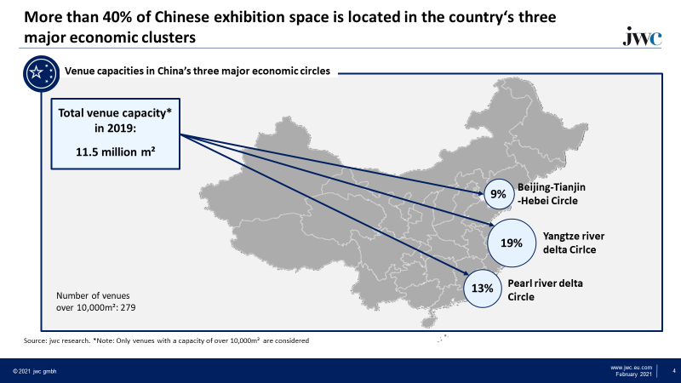
Chapter 3 – The Chinese exhibition market
In this special section, new insights about the Chinese market will be revealed, based on latest market research. Such insights will provide new perspectives on Chinese venues and market size, as well as latest insights into the structure and developments of the Chinese market
A
Exhibition market size expressed in major KPIs
PREVIEW
B
Venues and venue capacities; venues under development
Organizers, shows, ownership structures, verticals
C
D
Regional analysis: KPIs, economy, venues, shows, verticals,
Top-3 economic clusters: Beijing-Hubei, Yangtze Delta, Pearl River Delta
Tier-1 cities

Slide 11
Chapter 4 – Rush into virtual and omnichannel business model
This special section gives a broad overview of digital transformation in our industry and Covid-19’s impact. Jwc presents its approach to a seamless integration of digital and physical offerings, the omnichannel business model, and high-level recommendations on how to adopt it.
A
Megatrends stimulating digital business models
D
Lessons from the retail industry
The emergence of omnichannel business models
B
Digital offerings in the exhibition industry
E
Omnichannel business models for the exhibition industry
Concepts, benefits, requirements
C
Rush into virtual - Covid 19’s impact on the industry
Pre-covid times: profits from F2F, challenges for digital business models
Covid times: new virtual events ecosystem, digital replacement offerings and substitution of exhibitions
Post-covid times: Towards one-stop online platforms and omnichannel models
F
Conclusion and recommendations for show organizers

Slide 12
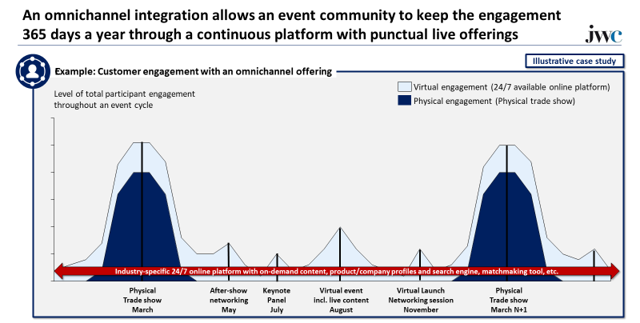
Chapter 4 – Rush into virtual and omnichannel business model
PREVIEW

